Slide 1
IS 597: Analysis changes in Lending data and relationship with state income
Group members:
Chuyang Li, Zheng Zhang, Yuting Xu

Slide 2

1. Introduction of lending club
Platform for borrowing personal loan
Allow individuals to lend to other individuals
Fixed rate and payment
Up to $40,000

Slide 3
2. Lending Club Loan Data Analysis

Slide 4
Hypothesis 1: The borrowers using Lending Club have worse economic situations than borrowers from all other lending resources
Indicators
Income; Debt; Debt/Income Ratio
Data
Survey of Consumer Finances
https://www.federalreserve.gov/econres/scf_2010.htm#EXCELDATEX
scfp2010
filter dp with debt
general borrower in 2010
borrower in 2019
general borrower in 2019
(adjusted to value of money in 2010)
scfp2019
filter dp with debt
adjust effect of inflation

Slide 5
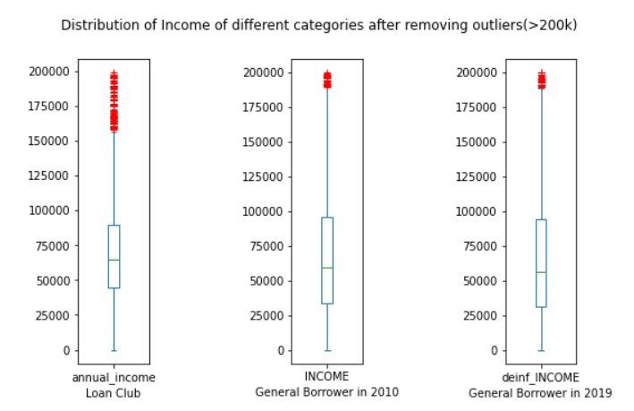
Hypothesis 1: The borrowers using Lending Club have worse economic situations than borrowers from all other lending resources
Income
upper boundary close to 90k
lower boundary of lending club higher than other two

Slide 6
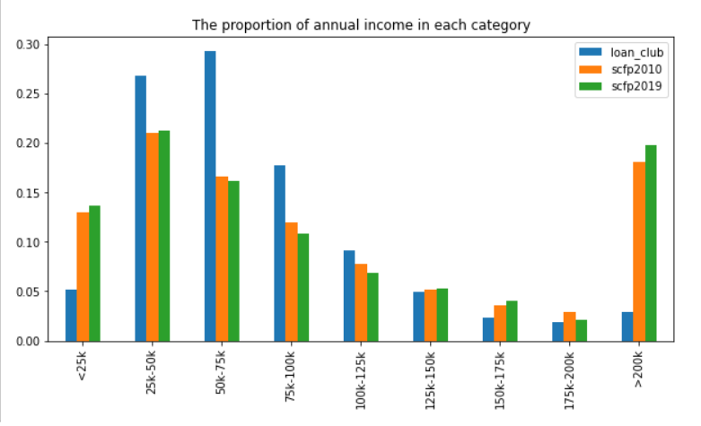
Hypothesis 1: The borrowers using Lending Club have worse economic situations than borrowers from all other lending resources
Income
club’s peak is at [25k-100k]
general borrower’s peak is at [0-50k], [>200k]
club has higher income distribution than general in the range of [25, 100k]
club has a smaller percentage of high-income group than general

Slide 7
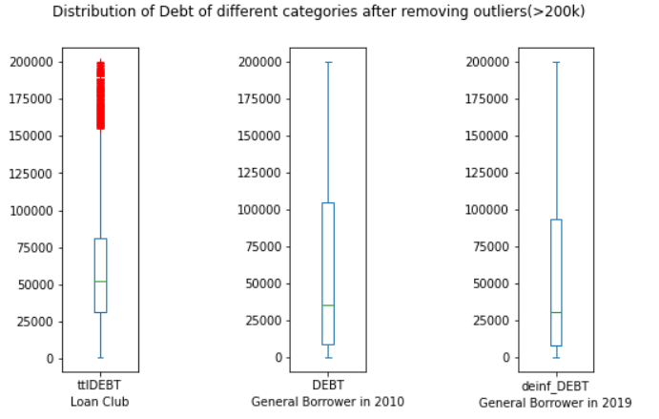
Hypothesis 1: The borrowers using Lending Club have worse economic situations than borrowers from all other lending resources
Debt
Debt = total credit utilized + loan amount
upper boundary of club lower than other two
lower boundary of club higher than other two

Slide 8
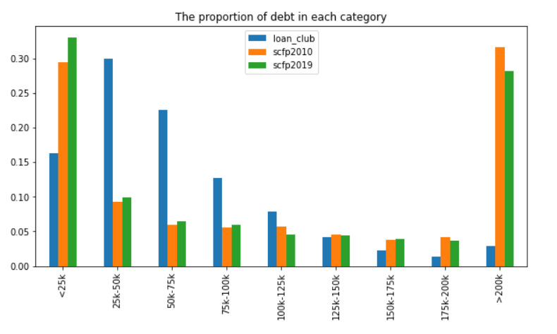
Hypothesis 1: The borrowers using Lending Club have worse economic situations than borrowers from all other lending resources
Debt
club’s peak is at [25k-75k]
general borrower’s peak is at [0-25k], [>200k]
club has higher debt distribution than general in the range of [25, 100k]
club has a higher debt amount proportion than general, beside the amount value greater than 200k

Slide 9
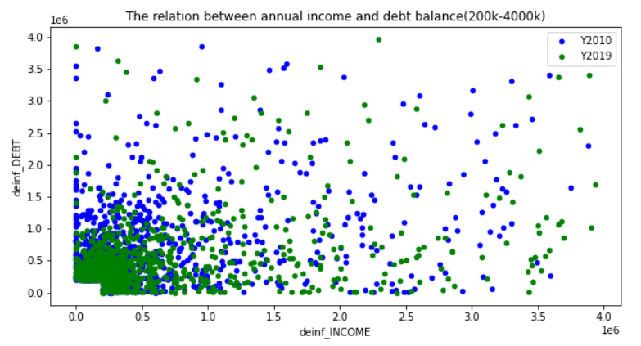
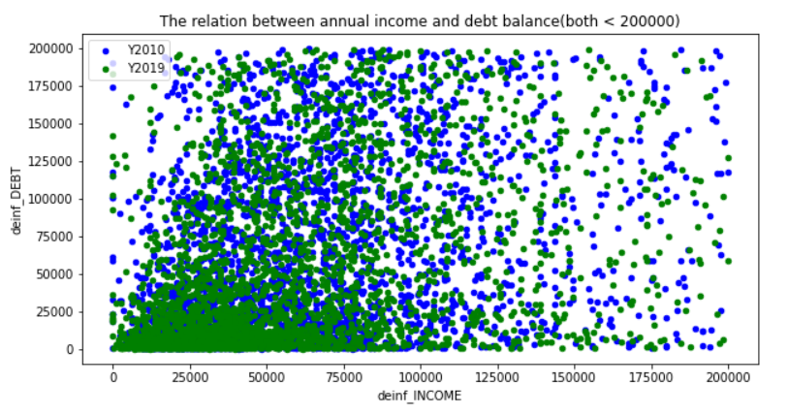
Hypothesis 1: The borrowers using Lending Club have worse economic situations than borrowers from all other lending resources
Is there any relationship between income and debt?
No.

Slide 10
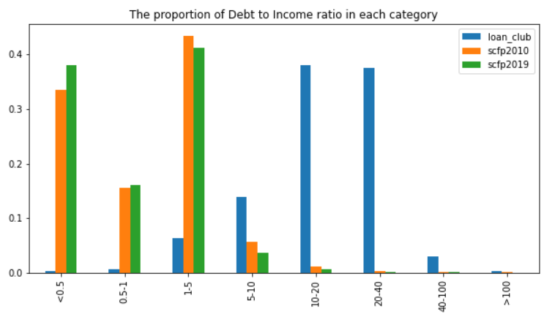
Hypothesis 1: The borrowers using Lending Club have worse economic situations than borrowers from all other lending resources
Debt-to-income ratio
40% General: D2I < 0.5
90% General: D2I < 1.5
90% club: D2I > 5
commercial banks D2I requirement: 0.43
lending club users have higher D2I than general

